Slide 1
Performing Natural Language Processing to Facilitate Data Analysis

Slide 2
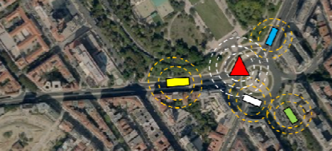
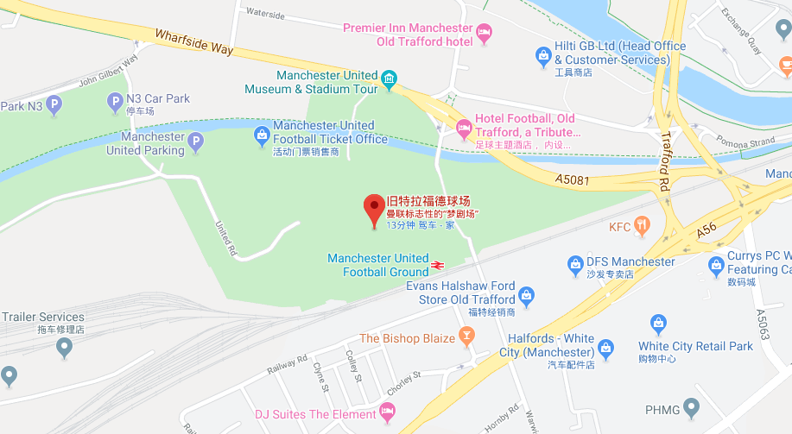
Decision makers in different domains such as healthcare, education and transportation, can gain significant advantages from the enormous volume of available data obtained from various data collection methods such as site-based sensors, cell-phone tracking [1] and social media. However, data collected via these methods are prone to Data Quality (DQ) problems, such as inaccuracy, incompleteness and heterogeneity [2, 3]. More recently, data management techniques for data profiling, cleaning and integration have been adapted to improve the quality of large amounts of raw data, in preparation for analysis or for machine learning. As more and more unstructured data (e.g., text written in natural language) becomes a component to be integrated with other types of data before analysis can be performed, challenges associated with Natural Language Processing (NLP) [4] need to be addressed in this scenario.
In this context, the main objectives of this project are the following: (i) to review the literature in data preparation for analysis, with a focus on data integration; (ii) to review the literature in techniques for NLP and identify the most appropriate techniques for the target use case; (iii) to review the background in the target use case; (iv) to design, implement and test a NLP solution for the target use case; (v) to design, implement and test a data preparation (and integration) process that includes the proposed NLP solution; (v) to select, configure and test a combination of the data preparation (and integration) process (including the NLP solution) with a machine learning algorithm for generating a prediction model based on training data resulting from the integrated/prepared data submitted to the proposed data preparation process.

Slide 3
In this context, the main objectives of this project are the following: (i) to review the literature in data preparation for analysis, with a focus on data integration; (ii) to review the literature in techniques for NLP and identify the most appropriate techniques for the target use case; (iii) to review the background in the target use case; (iv) to design, implement and test a NLP solution for the target use case; (v) to design, implement and test a data preparation (and integration) process that includes the proposed NLP solution; (v) to select, configure and test a combination of the data preparation (and integration) process (including the NLP solution) with a machine learning algorithm for generating a prediction model based on training data resulting from the integrated/prepared data submitted to the proposed data preparation process.

Slide 4
Time Plan

